Slide 1

AI-Driven Employee Feedback Analysis System
Group - 12

Slide 2
Group members:
Sk.Bashee – AP23110010241
D.Prabath – AP23110010565
G.Bhargav Sai – AP23110010435
S.Ajay Kumar – AP23110010211
P.Sujith – AP23110010541

Slide 3
Problem Statement & Objectives
Problem Statement:
Companies receive thousands of employee feedback comments, but manually analyzing them is slow, inaccurate, and fails to detect hidden workplace issues.There is a need for an automated system that can classify sentiment and extract workplace themes.
Objectives:
Automate sentiment classification of employee feedbackIdentify key workplace themes (e.g., salary, workload, management)Provide HR with actionable insights to improve employee satisfactionBuild an interactive web application for real-time feedback analysis

Slide 4
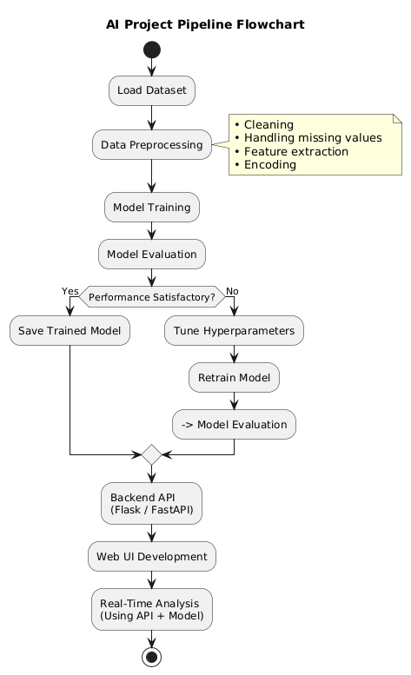
Proposed Solution
Workflow:
A web-based AI platform that:
Captures employee feedback
Performs real-time NLP processing
Predicts sentiment (positive/neutral/negative)
Extracts key workplace themes
Delivers actionable HR insights through a clean UI

Slide 5
Dataset & Methodology
Dataset:
Source: Kaggle – Employee Reviews Dataset Columns used: feedback/comment, ratings, pros/cons
Size: 10,000+ reviews
Type: Unstructured text data
Methodology:
Data Cleaning (lowercase, remove noise, stopwords)
2. Tokenisation & Lemmatisation
3. TF-IDF Vectorisation
4. Sentiment Labelling from ratings
5. Train-Test Split (80-20)
6. Model Training (Naive Bayes / Logistic Regression)
7. Theme extraction using TF-IDF & frequency analysis

Slide 6
Technologies Used
Web Technologies
Flask / FastAPI
HTML, CSS, Bootstrap
JavaScript
Backend & ML
Python, NumPy, Pandas
Scikit-learn, NLTK, TextBlob
TF-IDF Vectorizer
Pickle for model saving
Visualization
Matplotlib
WordCloud

Slide 7
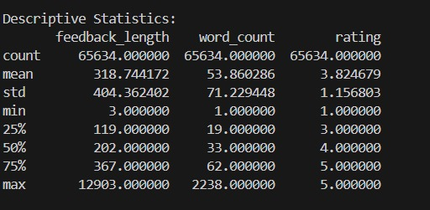
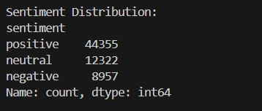
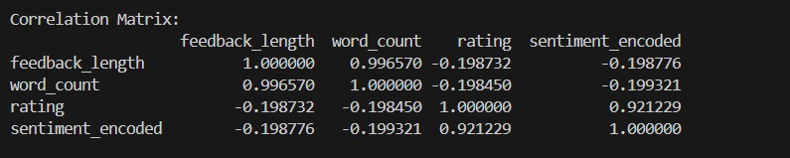
Results & Findings

Slide 8
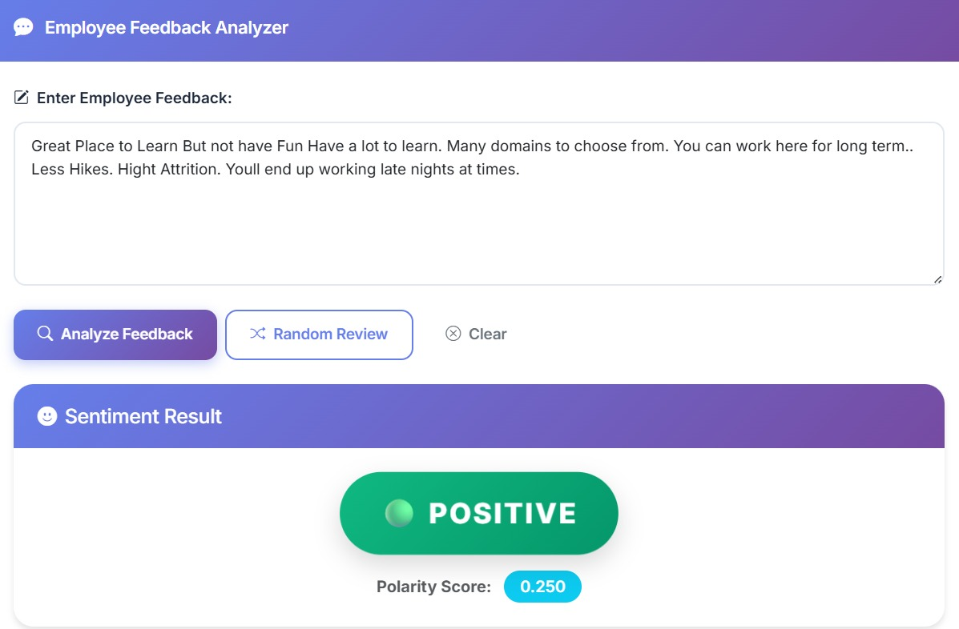
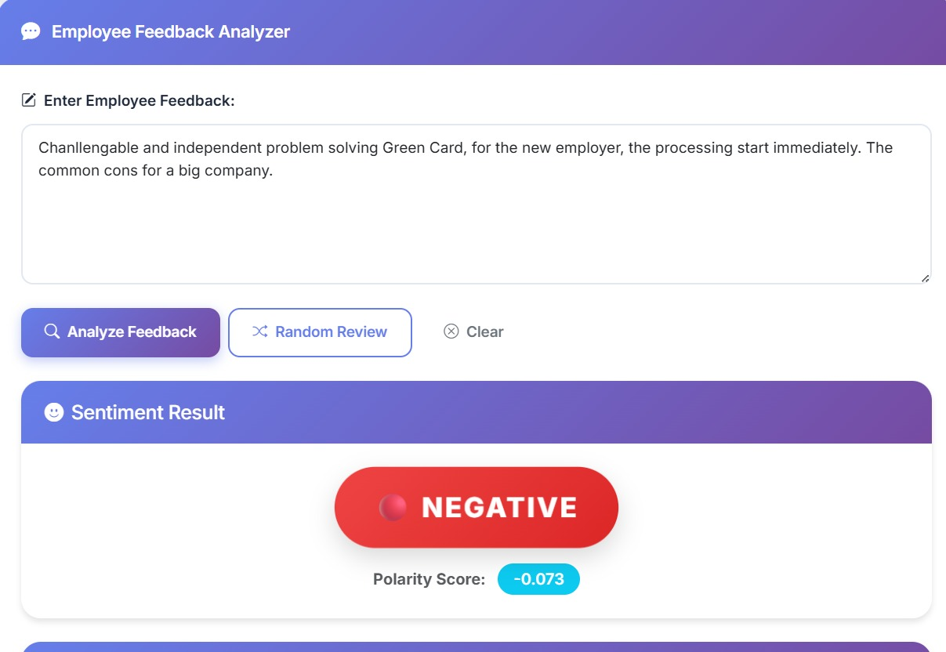

Slide 9
Conclusion & Future Scope
Conclusion
This project successfully built an AI-powered system capable of:
Automatically analyzing employee feedback
Extracting workplace themes
Assisting HR in decision-making
Providing real-time results via web app
Future Scope
Multilingual feedback support
Integration with company HRMS systems
Advanced emotion detection using transformers
Department-wise sentiment dashboards
Integration with chatbot for anonymous feedback

